Slide 1
CMake Tutorial
Introduction
The CMake tutorial provides a step-by-step guide that covers common build system issues that CMake helps address.

Slide 2
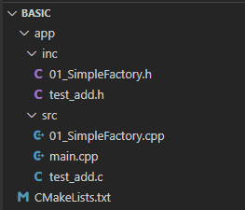
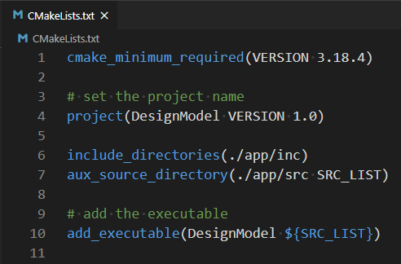
A Basic Starting Point

Slide 3
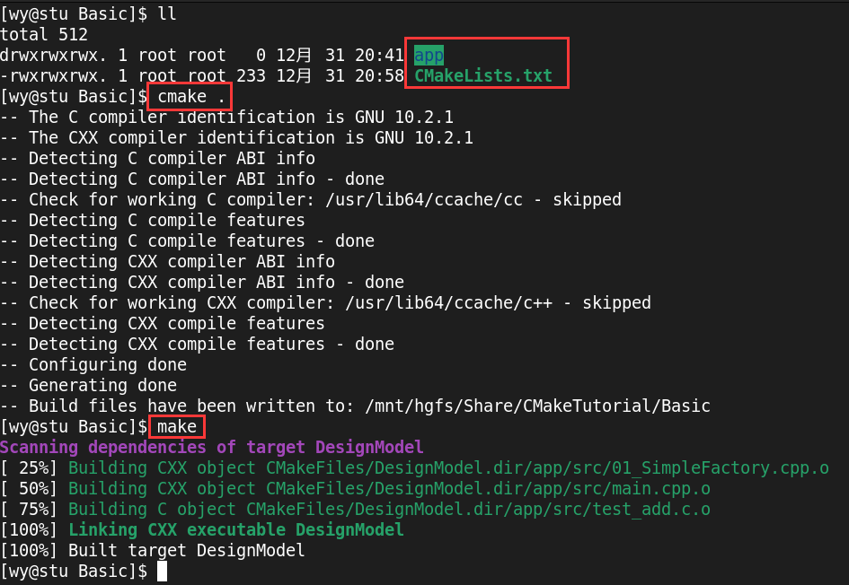
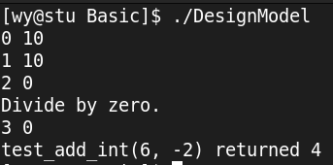
A Basic Starting Point

Slide 4
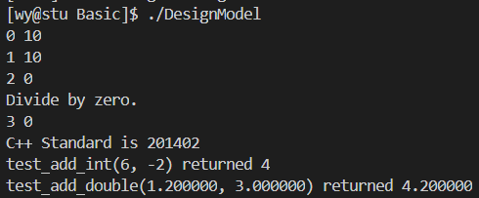
Specify the C++ Standard
# specify the C++ standard
set(CMAKE_CXX_STANDARD 11)
set(CMAKE_CXX_STANDARD_REQUIRED True)
Default C++ Standard

Slide 5
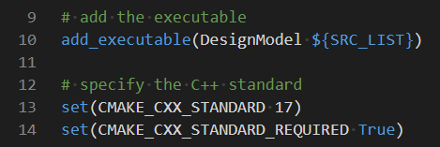
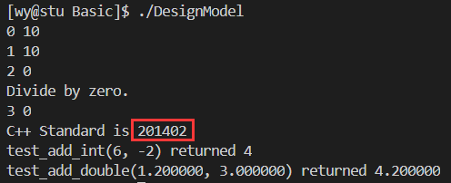
Specify the C++ Standard
Make sure to add the CMAKE_CXX_STANDARD declarations above the call to add_executable.
NOT Match & Why ?
Output

Slide 6
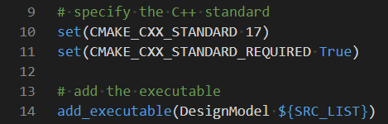
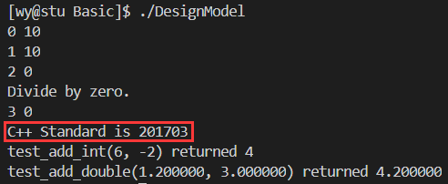
Specify the C++ Standard
It works well.

Slide 7
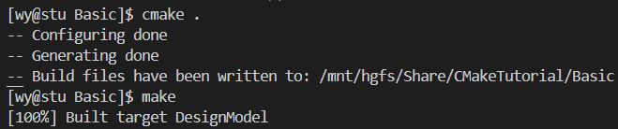
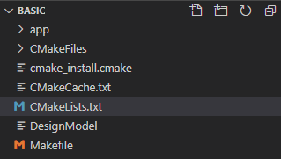
Build and Test
$ cmake .
$ make
A lot of Cmake content is generated under the basic directory

Slide 8
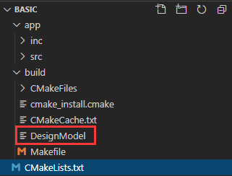
Build and Test
$ mkdir build && cd build
$ cmake ..
$ make
It looks a lot fresher.

Slide 9
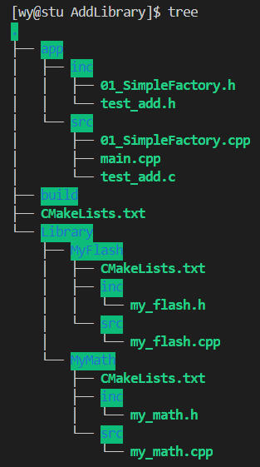
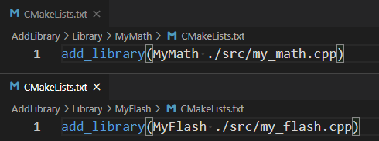
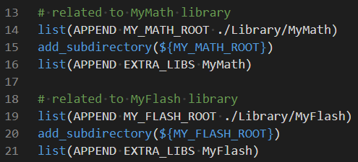
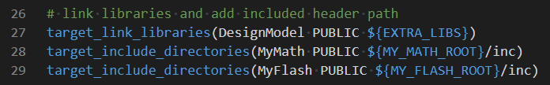
Adding a Library
Main CmakeLists.txt

Slide 10
Adding a Library
To make use of the new library we will add an add_subdirectory() call in the top-level CMakeLists.txt file so that the library will get built.
Note the use of the variable EXTRA_LIBS to collect up any optional libraries to later be linked into the executable.

Slide 11
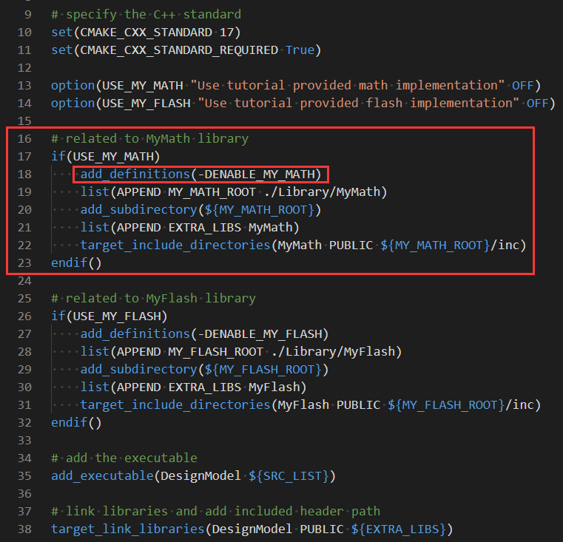
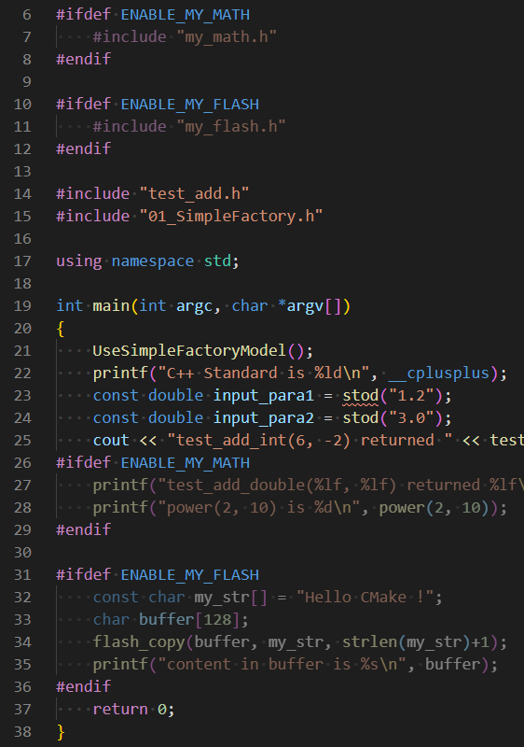
Adding a Library
Now let us make the MyMath & MyFlash library optional. While for the tutorial there really isn’t any need to do so, for larger projects this is a common occurrence.

Slide 12
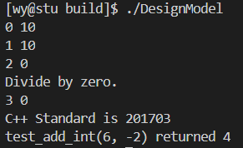
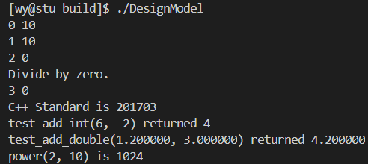
Adding a Library
$ mkdir build && cd build
$ cmake ..
$ make && ./DesignModel
$ mkdir build && cd build
$ cmake .. –DUSE_MY_MATH=ON –DUSE_MY_FLASH=OFF
$ make && ./DesignModel

